Slide 1
Fraud Detection Using Blended Modeling and Reinforcement Learning
A Data Science Approach to Identifying Fraudulent Transactions
Donn Bryan Julian
Date: 12/2/2024

Slide 2
Executive Summary
Objective:
Develop a machine learning model to detect fraudulent transactions effectively.
Key Takeaway:
A blended model, combining ensemble learning and reinforcement learning, achieves high accuracy with enhanced feature understanding.

Slide 3
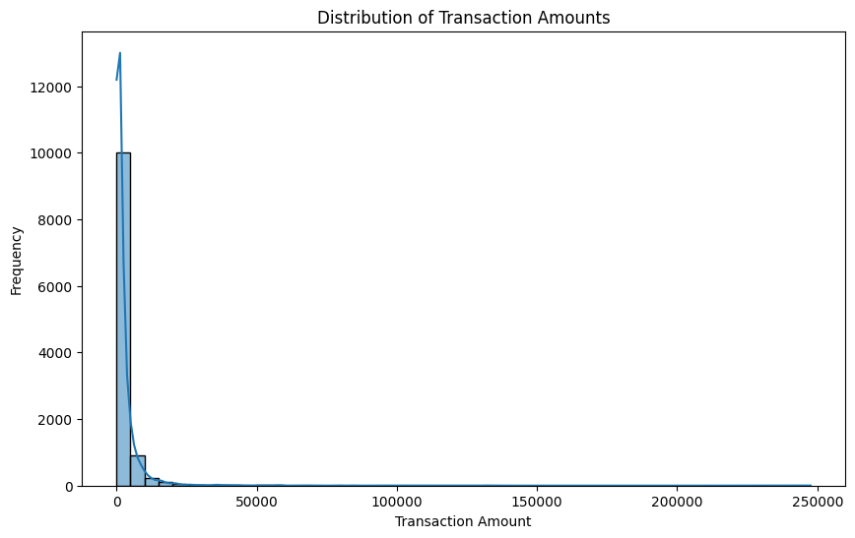
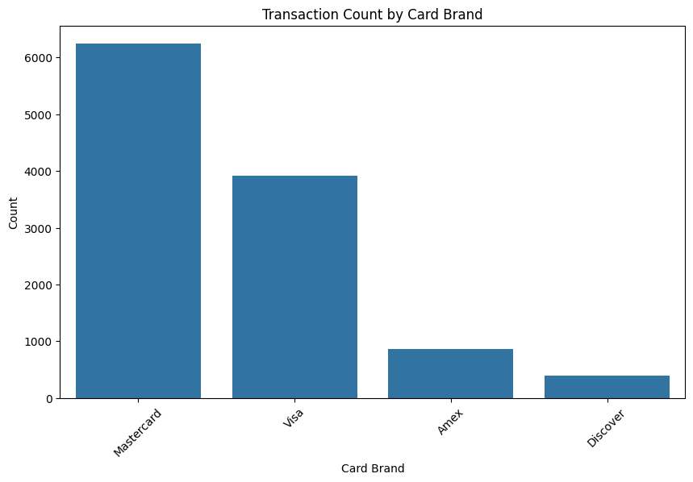

Slide 4
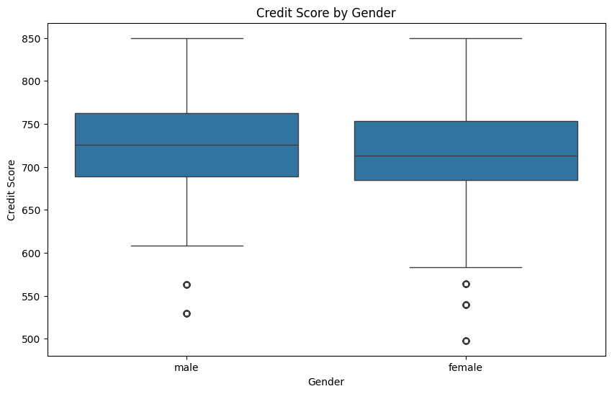
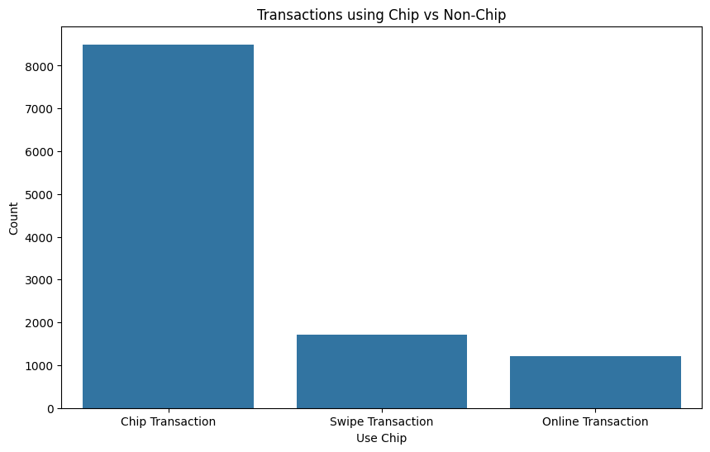

Slide 5
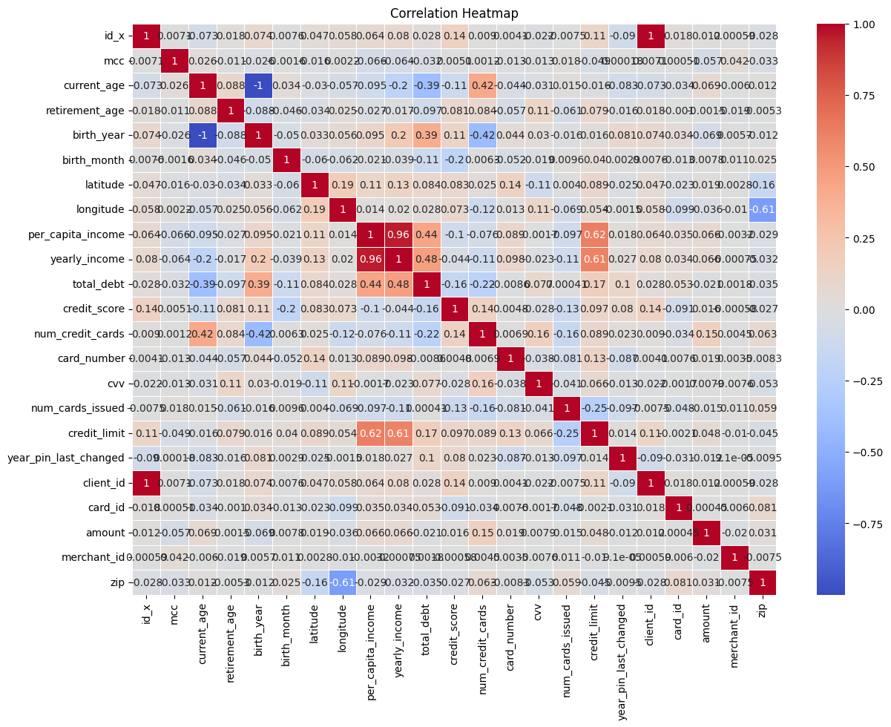

Slide 6
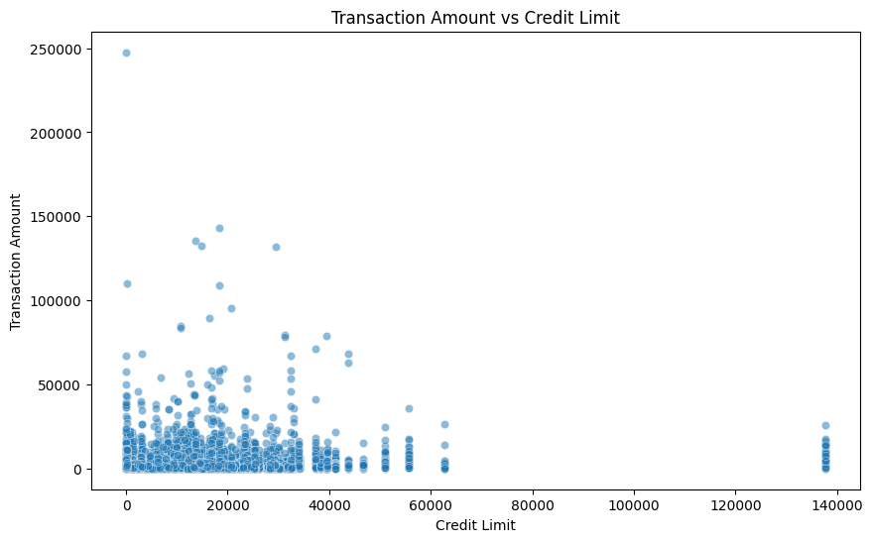
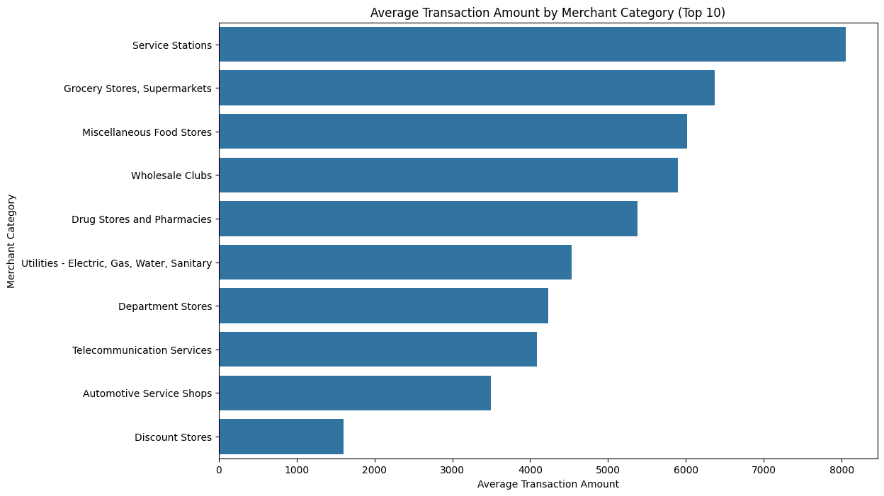

Slide 7
Business Problem
Context: Financial fraud poses significant financial risks.
Goal: Enhance the identification of fraudulent transactions with minimal false positives, ensuring business security and customer trust.
Impact: Reduced fraud-related losses and improved customer experience.

Slide 8
Methodology Overview
Modeling Approach:
Blended model with ensemble methods (Naive Bayes, Support Vector Classifier, Logistic Regression).
Reinforcement Learning for fine-tuning model performance.
Feature Engineering: Focused on identifying key features like total debt, transaction amount, and credit limit.

Slide 9
Model Development
Ensemble Approach: Combined models to leverage diverse strengths.
Reinforcement Learning: Applied Deep Q-Learning to adaptively adjust model weights for optimal performance.
Regularization: Addressed overfitting by tuning hyperparameters and increasing model robustness.

Slide 10
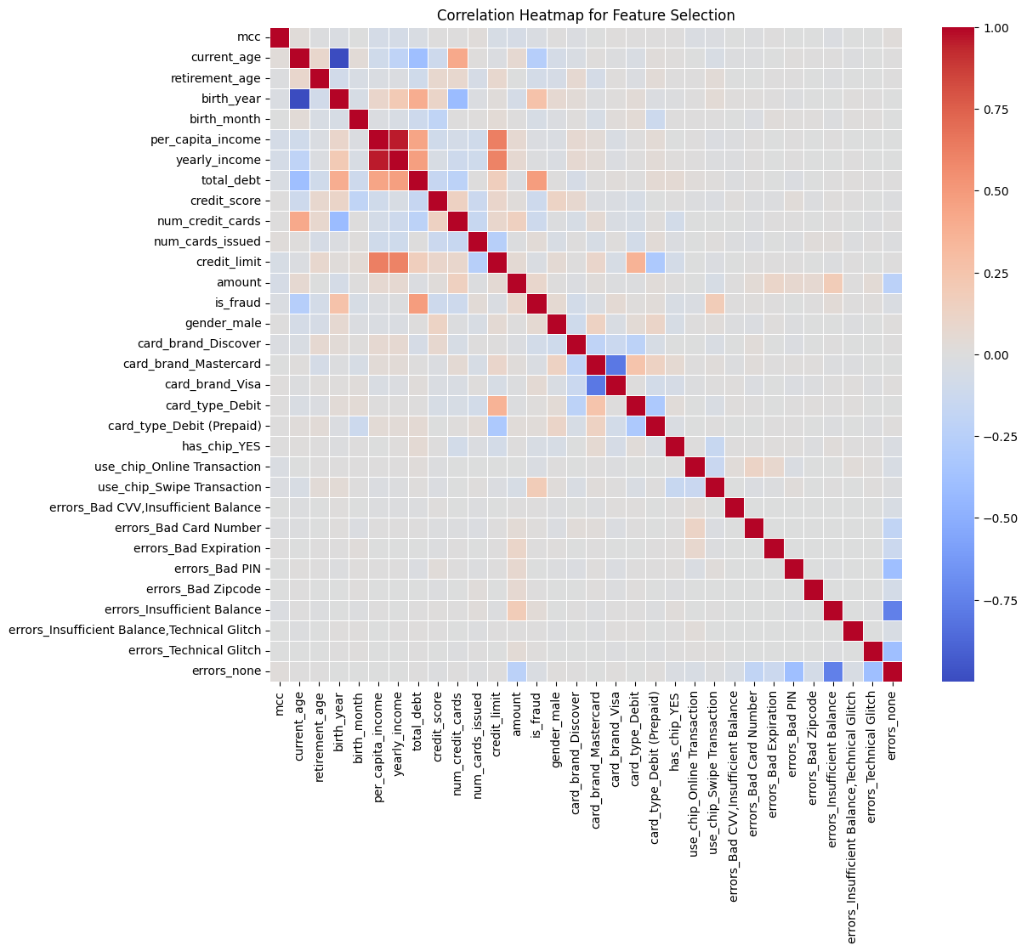

Slide 11
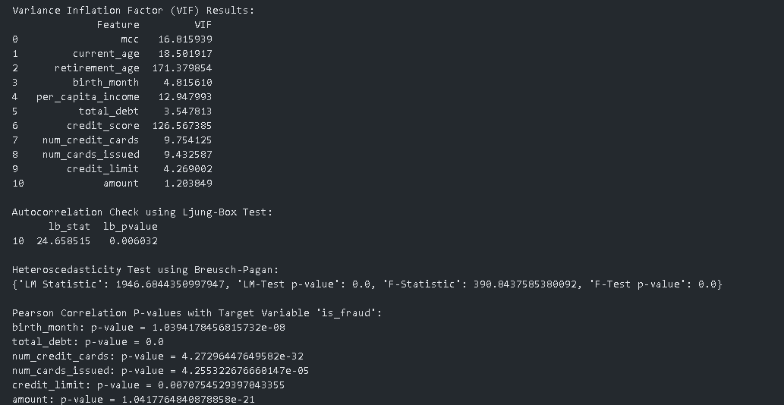
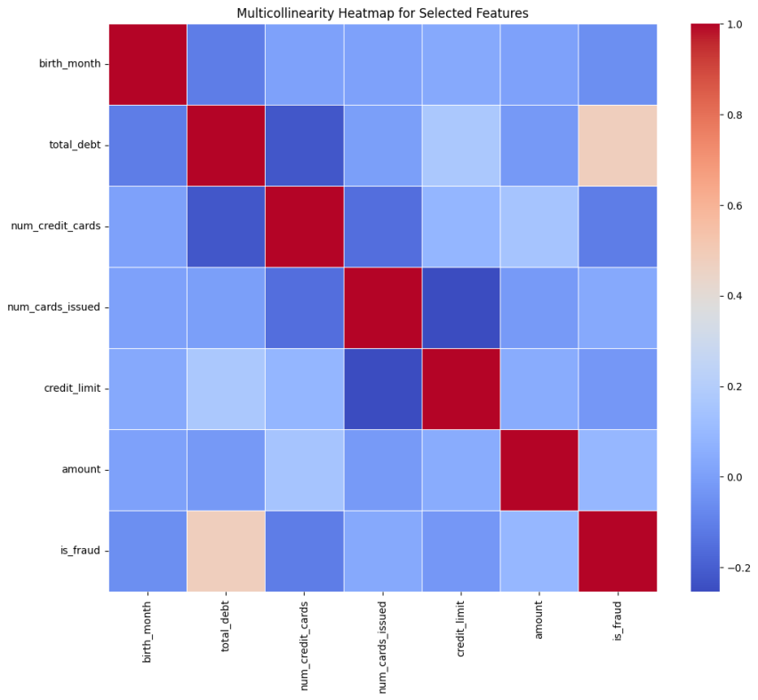

Slide 12
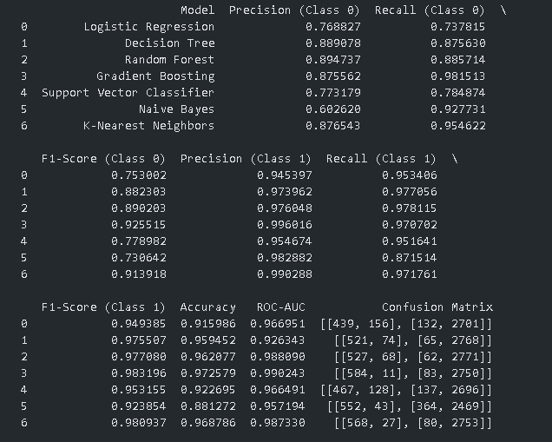
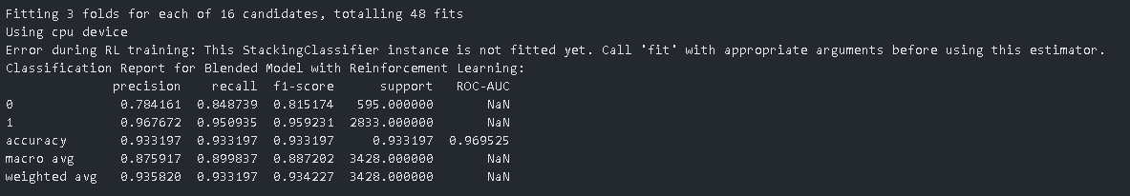

Slide 13
Key Results
Performance Metrics:
Accuracy: 93.5%
Precision: High focus on reducing false positives.
Recall: Captured a high proportion of actual fraud cases.
Model Impact:
The refined blended model provided a balanced outcome, minimizing both false positives and false negatives.

Slide 14
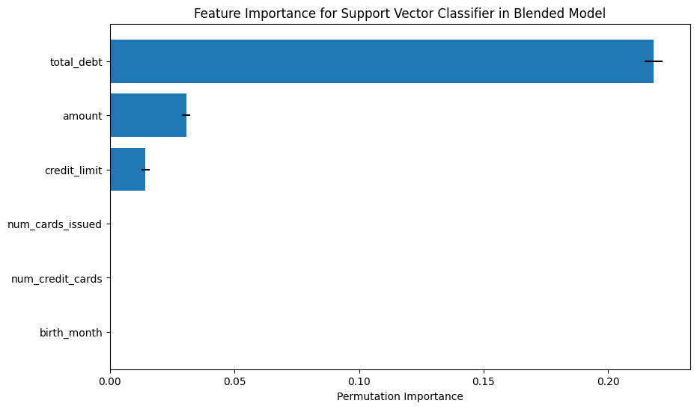
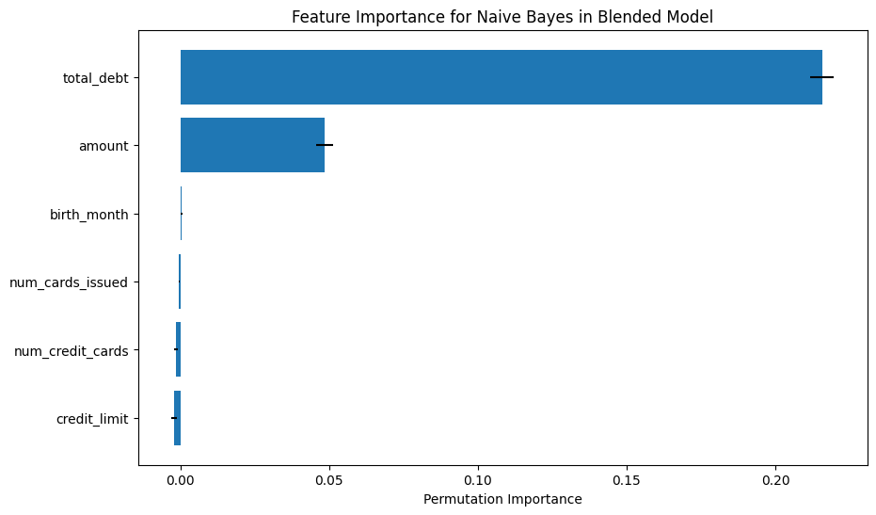
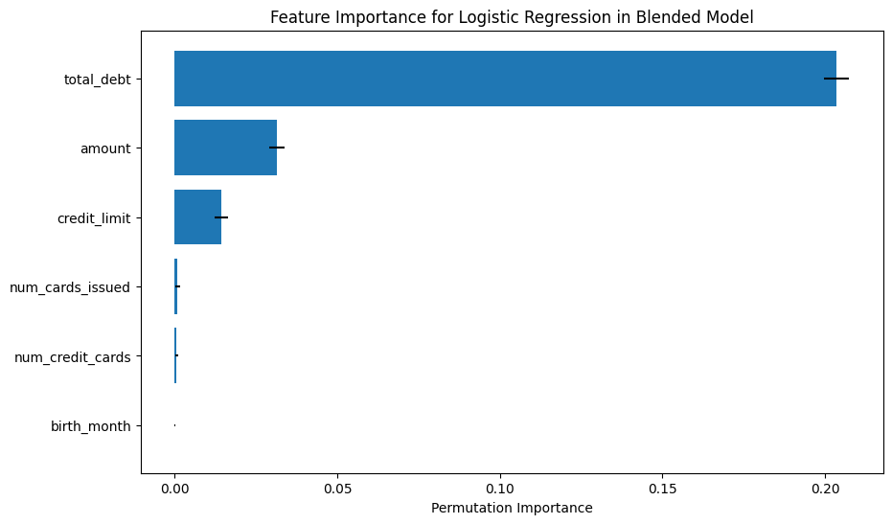

Slide 15
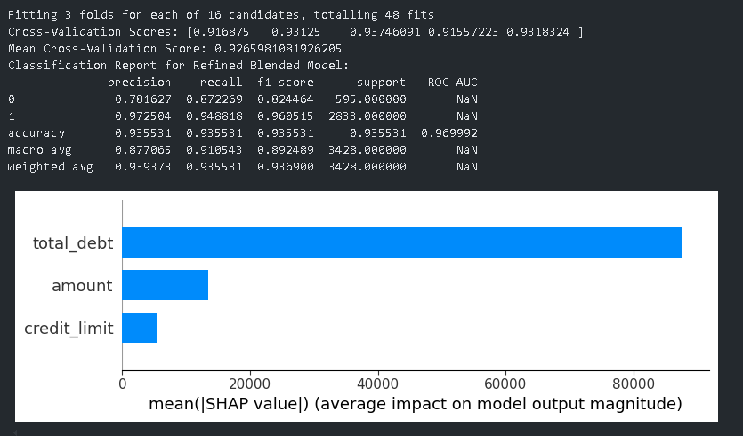

Slide 16
Feature Importance
Top Features:
Total Debt: Strongest predictor of fraudulent activity.
Transaction Amount: Significant impact on detection.
Credit Limit: Provided additional context for model predictions.
Insights:
Focus on reducing customer debt and monitoring high-value transactions for fraud indicators.

Slide 17
Refinement Process
Optimization: Removed less significant features to streamline the model.
Cross-Validation: Improved model consistency and reduced overfitting risks.
Conclusion: Achieved a well-balanced, reliable fraud detection model.

Slide 18
Deployment Strategy
Scalable API:
Implemented a RESTful API for easy integration into existing systems.
Real-time Predictions:
Immediate fraud detection using a Flask web service.
Business Impact:
Faster response times, improved fraud detection accuracy, and enhanced security.

Slide 19
Key Business Benefits
Fraud Reduction:
Significant reduction in fraudulent activities.
Customer Trust:
Improved due to fewer false alarms and better service.
Operational Efficiency:
Automated fraud detection reduces manual review costs.

Slide 20
Next Steps
Model Monitoring:
Implement continuous model monitoring to ensure performance stability.
Scalability:
Plan for deployment in other regions or across different transaction types.
Feedback Loop:
Integrate a feedback mechanism to enhance model training with real-world data.

Slide 21
Conclusion
Summary:
The blended model effectively detects fraud, balancing recall and precision while minimizing false positives.
Call to Action:
Approve deployment to production for enhanced fraud management.

